Slide 1
Session plan
-First half
Group work: Interim assignment tasks
-Second half
Worksheet
Worksheet: Check your answers

Slide 2
Seminar activity – interim assignment tasks
CEO
Who are William Hill’s main competitors?
How is performance measured in the gambling sector? How has the sector been performing?
How has William Hill been growing it’s business?
Who would the suppliers be for William Hill?
What was the stock market value of William Hill in mid- 2020 (when the takeover bid was made)?
What has impacted on Caesars in 2020?

Slide 3
Where to find sector info
Google searches (Evaluate reliable sources)
Mintel reports
Newspaper reports

Slide 4
Seminar activity – interim assignment tasks
CFO
What was William Hill’s sales & % growth in 2020?
What was the EBITDA figure (& % of sales) in 2020?
What was the depreciation & amortisation (D&A)?
What rate of corporation tax applied in 2020?
What was the working capital requirement (WCR) movement for 2020?
What was the free cash flow (FCF) for 2020?
What are the problems in forecasting FCF?

Slide 5
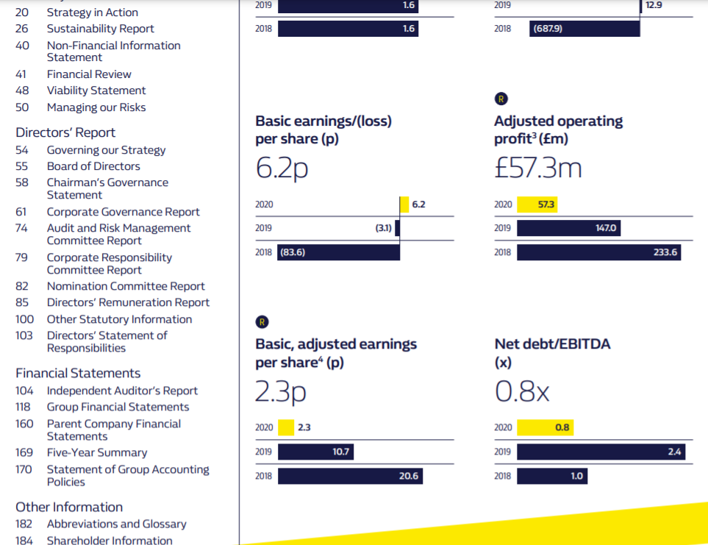
Where to find William Hill financial info

Slide 6
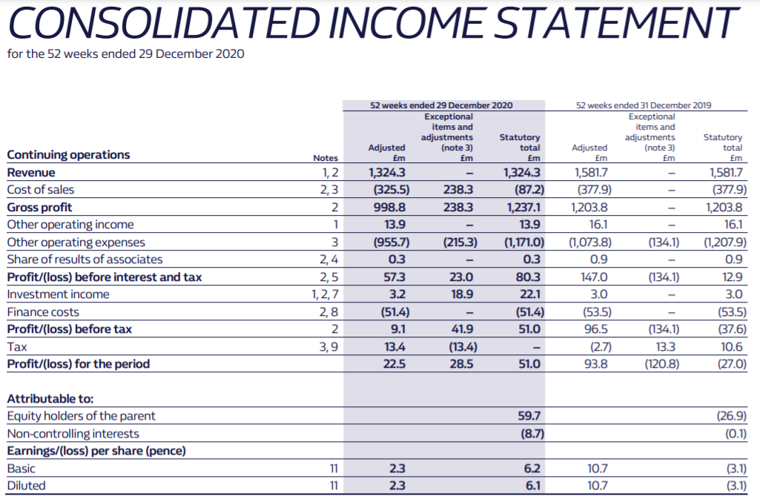
Examples: William Hill financial info
Sales
EBIT

Slide 7
Calculate sales growth
((2020 sales) – (2019 sales)) / (2019 sales) x 100 =%
(1,324.3 – 1,581.7) / 1,581.7 x 100 = -16%

Slide 8
Tip: Searching for a particular financial info
You may not be able to find some information you need in the main financial reports, because the format depends on the company
You can try a text search in the annual report if you cannot find the information you want in the main financial reports

Slide 9
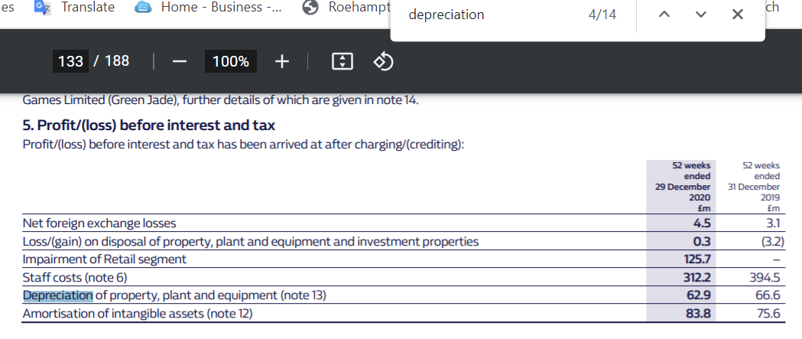
Example of text search (D&A)
D&A
D & A

Slide 10

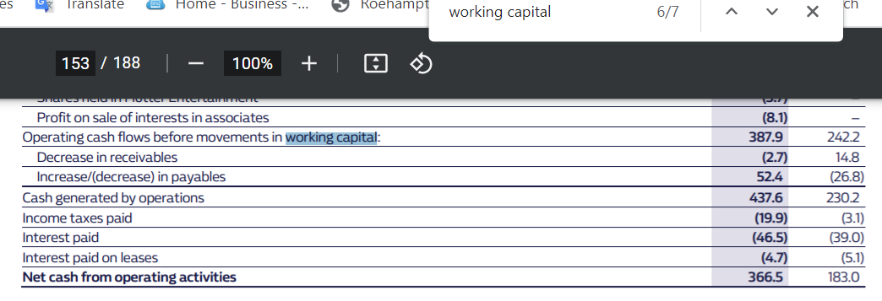
Example of text search

Slide 11
Seminar activity – interim assignment tasks
CRO
What are the main business risks identified by William Hill (in the 2020 annual report)?
What risks and opportunities would you expect in the gambling sector?
What risks often apply to takeovers in general? (see week 6 reading, Harris (2007) & week 7 lecture)
What risks might apply to the new owners of William Hill? (see Caesars annual report)
Would these vary for other possible bidders?

Slide 12
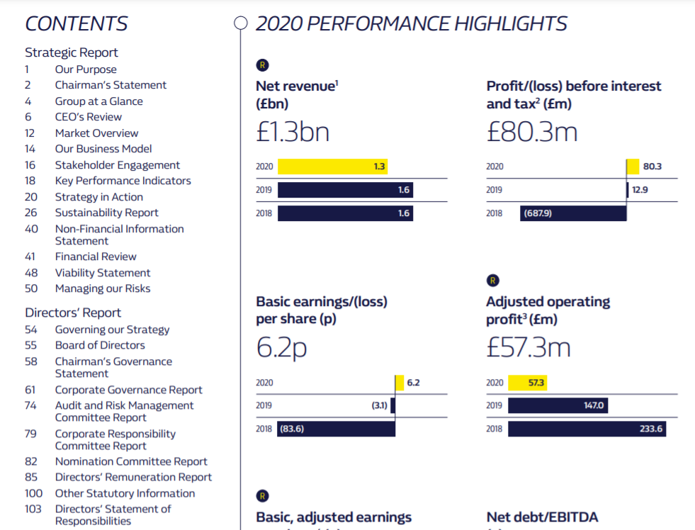
Where to find William Hill risk info

Slide 13
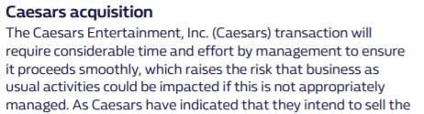
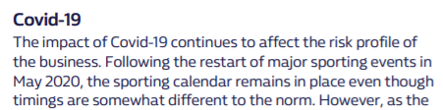
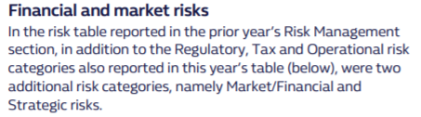

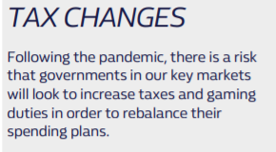
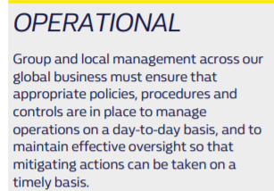
Examples: William Hill risk factors
Extracted from Pages 51 to 52 in annual report

Slide 14
Group work
Identify your role (MBA: CEO, MSc: CFO)
Form groups by role
Discuss the interim assessment tasks of your role in the group
Select a person who presents your group’s discussion
Each group shares what their group discussed

Slide 15
Interim assessment tasks
CFO
What was William Hill’s sales & % growth in 2020?
What was the EBITDA figure (& % of sales) in 2020?
What was the depreciation & amortisation (D&A)?
What rate of corporation tax applied in 2020?
What was the working capital requirement (WCR) movement for 2020?
What was the free cash flow (FCF) for 2020?
What are the problems in forecasting FCF?
CEO
Who are William Hill’s main competitors?
How is performance measured in the gambling sector? How has the sector been performing?
How has William Hill been growing it’s business?
Who would the suppliers be for William Hill?
What was the stock market value of William Hill in mid- 2020 (when the takeover bid was made)?
What has impacted on Caesars in 2020?

